Slide 1
Problem Statement
High-quality images play a crucial role in various fields such as photography, medical imaging, surveillance, and satellite imaging. However, the prevalence of blurred or low-quality images due to camera limitations, environmental conditions, or motion presents a significant challenge. Blurred images can lead to misinterpretation of critical information, reducing their utility and reliability. For instance, in medical imaging, blurred images can result in inaccurate diagnoses, potentially endangering patients' lives. Traditional image restoration techniques often fall short in addressing the complexity and diversity of image degradation, making it imperative to explore advanced solutions. Existing methods may rely on simple filters or heuristic-based approaches, which lack the capability to handle diverse types of blurs and artifacts effectively. Moreover, manual intervention in image restoration processes is time-consuming and not scalable, especially when dealing with large datasets. Despite significant progress, there remains a gap in developing efficient and user-friendly solutions that can automatically restore blurred images to their original sharpness without requiring expert knowledge or manual adjustments.

Slide 2
Unique Idea Brief (Solution)
The proposed solution leverages the UNET architecture, a powerful convolutional neural network (CNN) designed for image-to-image translation tasks, to restore blurred images to their original sharpness. he unique aspect of our solution lies in its ability to handle a wide variety of blurs and artifacts, making it robust and versatile across different types of images and use cases. The UNET architecture, with its encoder-decoder structure and skip connections, excels in capturing fine details while maintaining contextual information, which is crucial for accurate image restoration. This solution also includes a user-friendly interface that allows users to upload blurred images and receive restored versions seamlessly. The interface is designed to be intuitive, enabling users without technical expertise to benefit from advanced image restoration capabilities. By automating the restoration process, the solution saves time and effort, making it scalable for large datasets. Unlike traditional methods that often rely on heuristic filters or manual adjustments, this approach employs deep learning to automatically learn the complex patterns of image degradation and restoration.

Slide 3
Features Offered
These features are built on the robust UNET architecture and tailored to meet the diverse needs of users across different domains.
Automatic Image Restoration: The core feature of the solution is its ability to automatically restore blurred images without requiring manual intervention.
User-friendly Interface: Users can easily upload blurred images and view the restored images through a simple and straightforward process.
Integration Capabilities: The solution can be easily integrated with existing systems and workflows.
Continuous Improvement: The solution is designed with a focus on continuous learning and improvement.
Robust Performance: Trained on a diverse dataset with extensive data augmentation, the model is capable of handling various types of blurs and artifacts.

Slide 4
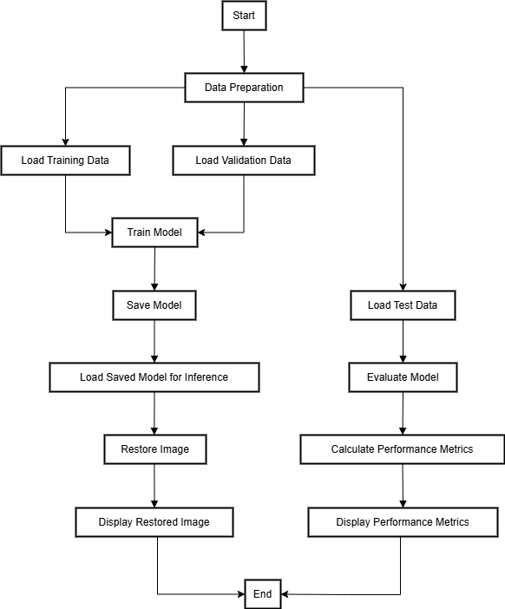
Process flow

Slide 5
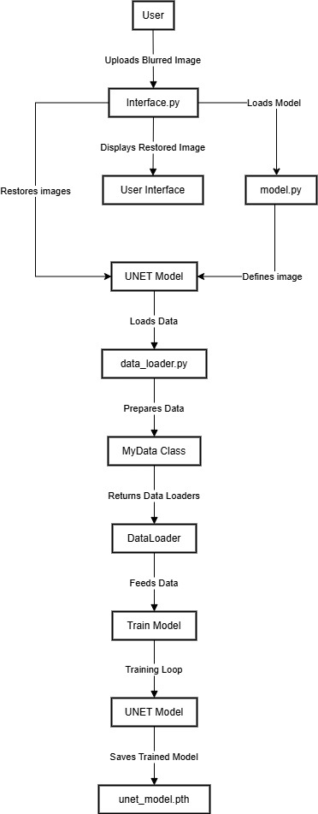
Architecture Diagram

Slide 6
Technologies used
The technologies used in the image restoration solution are chosen to ensure robustness, scalability, and efficiency.
Programming Languages:
Python: Python is the primary programming language used for developing the solution.
Deep Learning Framework:
PyTorch: PyTorch is used for implementing and training the UNET model.
Development Tools:
Jupyter Notebooks: Jupyter Notebooks are used for developing and experimenting with the model.

Slide 7
Team members and contribution:
Tripurari Venkata Srikar (Role: Team lead ):
Contribution : Worked on implementing core functionality of the UNET model and the overall integration of the project. Trained a model based on this UNET architecture .
Shaik Abdul Rahman (Role: Team member ):
Contribution : Worked on utilizing Convolution Neural Networks (CNN) for feature extraction and image reconstruction.
Devalapalli Venkata Prabhavathi (Role: Team member ):
Contribution : Worked on enhancing UNET architecture to boost its performance in image to image translation tasks. Provided various approaches using various packages like pillow and OpenCV.
Bethi Sravanthi (Role: Team member ):
Contribution : Worked on collecting the datasets and creating a approach for loading and preprocessing the data which can be accessed by the model in training.
Mareddy Prabhakar Reddy (Role: Team member ):
Contribution : Worked on creating user interface for easy interaction.

Slide 8
Conclusion
The UNET model-based image restoration solution represents a significant advancement in image processing, addressing the pervasive issue of blurred images. It offers a robust, scalable, and user-friendly solution with potential applications across various industries. The project followed a structured and comprehensive approach from problem identification to solution implementation and validation, emphasizing the critical need for effective image restoration in fields like medical imaging, surveillance, and photography. The innovative use of the UNET architecture for automatic image restoration and the detailed features of the solution underscore its capabilities, including real-time processing, scalability, and a user-friendly interface. The architecture diagram visually represented the system's structure, and the technologies used were carefully chosen to ensure robustness, efficiency, and scalability. The project demonstrates the power of deep learning in solving complex image restoration tasks and the importance of a well-coordinated, interdisciplinary approach to problem-solving, aiming to improve image quality and utility across various applications.

